Slide 1
Rockbuster Stealth
Data analysis

Slide 2
Background information
Rockbuster Stealth LLC is a movie rental company that had stores around the world. Facing stiff competition from streaming services such as Netflix and Amazon Prime, the Rockbuster Stealth management team is planning to use its existing movie licenses to launch an online video rental service in order to stay competitive.
Need to come up with a strategy for their own online video service.

Slide 3
Key questions
Which movies led in sales?
Which movies were the lowest in sales?
Do sales vary in geographic regions?
What was the average rental duration?
What countries are Rockbuster customers based in?

Slide 4
Movie Rental Statistics
Rental Rate
Min- $0.99
Max- $4.99
Avg- $2.98
Rental Duration
Min- 3
Max – 7
Avg- 5
Replacement Cost
Min- $9.99
Max- $29.99
Avg- $19.99
Movie Length
Min- 46 minutes
Max- 185 Minutes
Avg- 115 Minutes

Slide 5
What movies led in rental sales?
Telegraph Voyage led the sales with $215.75

Slide 6
Which movies were the ones with least revenue?
Texas watch, Oklahoma Jumanji, and Duffel Apocalypse were the worst movies based off rental sales

Slide 7
Average Rental Duration
The average rental duration was between 4 and 6 days.
The longer rental genres are Thriller and Travel.
The shorter rental genres are New and Sports

Slide 8
Top Grossing Genres
The highest rented genres are Sports followed by Sci-Fi.

Slide 9







Which countries are Rockbuster customers based in?
Top 5 Countries with the Highest Number of Customers
 | India 60
 | China 53
 | United States 36
 | Japan 31
 | Mexico 30

Slide 10
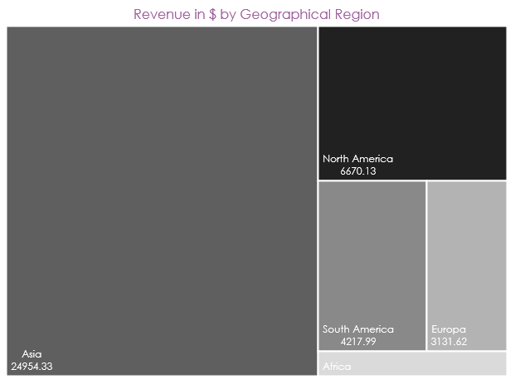
Do sales vary by region?
Asia dominates the market, followed by North America

Slide 11
Where are the most loyal customers?
India and China have the most customers and that attributes to them having the most valuable customers.

Slide 12
Recommendations
Focus on the marketing and promotion in the most valuable market, Asia
Do a rewards/loyalty program to incentivize customers
Have a diverse library of movies
Add similar movies to those that are highest grossing
Eliminate the low revenue movies

